Slide 1
Impact of Inflation and Unemployment on Economic Growth
Descriptive Statistics
Presented by: Muhammad Usman

Slide 2
Table 1
Variables Information
Variable | Description | Measurement | Data Sources
EG (Y) | Economic Growth | GDP Growth (annual %) | World Development Indicators
Infl | Inflation | Inflation, GDP deflator (annual %) | World Development Indicators
Unemp | Unemployment | Unemployment, total (% of total labor force) (modeled ILO estimate) | World Development Indicators
ER | Exchange Rate | Official exchange rate (LCU per US$, period average) | World Development Indicators
MS | Money Supply | Broad money (% of GDP) | WDI + Respective Central Banks + Government Operated Statistics Bureau
Inv | Investment | Gross fixed capital formation (% of GDP) | WDI + Respective Central Banks + Government Operated Statistics Bureau
Sav | Savings Rate | Gross domestic savings (% of GDP) | World Development Indicaters
IR | Interest Rate | Lending interest rate (%) | WDI + Respective Central Banks + Government Operated Statistics Bureau
ddummy | Dummy for Developed | =1 for Developed, = 0 for Developing

Slide 3
Summary Statistics

Slide 4
Summary Statistics

Slide 5
Summary Statistics: Developed Countries Data

Slide 6
Summary Statistics: Developed Countries Data

Slide 7
Summary Statistics: Developing Countries Data

Slide 8
Summary Statistics: Developing Countries Data

Slide 9
Correlation Matrix

Slide 10
Correlation Matrix: Developed Countries

Slide 11
Correlation Matrix: Developing Countries

Slide 12
T-test of Mean Comparison
H₀: no significant difference between means of the variables in developed countries and developing countries.
H₁: significant difference between means of the variables in developed countries and developing countries

Slide 13


Descriptive (Average 2021)

Slide 14


Descriptive (Average 2021)

Slide 15


Descriptive (Average 2021)

Slide 16

Descriptive (Average 2021)

Slide 17
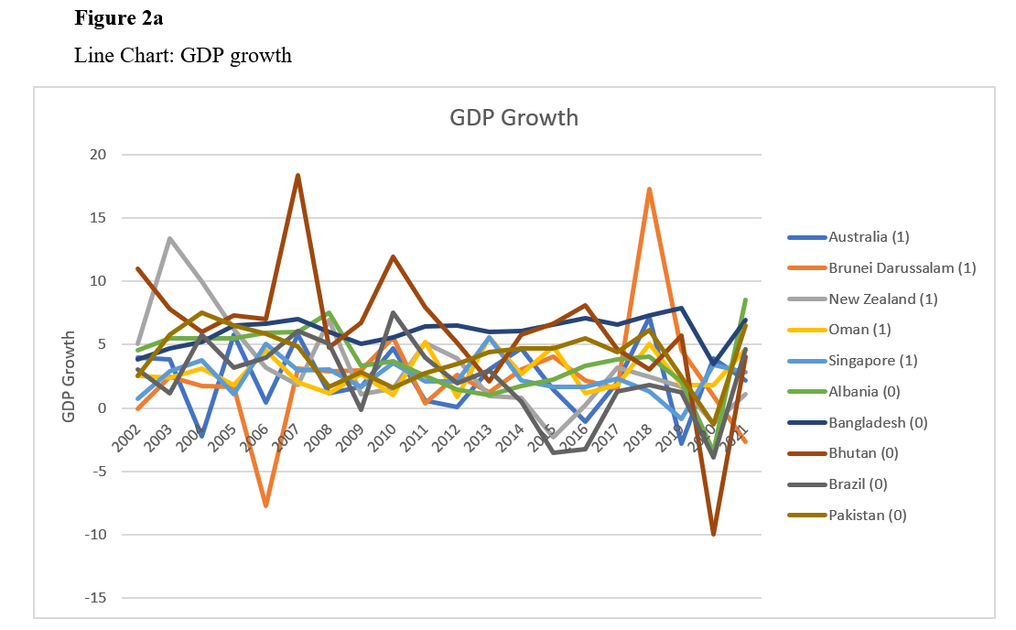
Descriptive : GDP Growth (2002-2021)

Slide 18
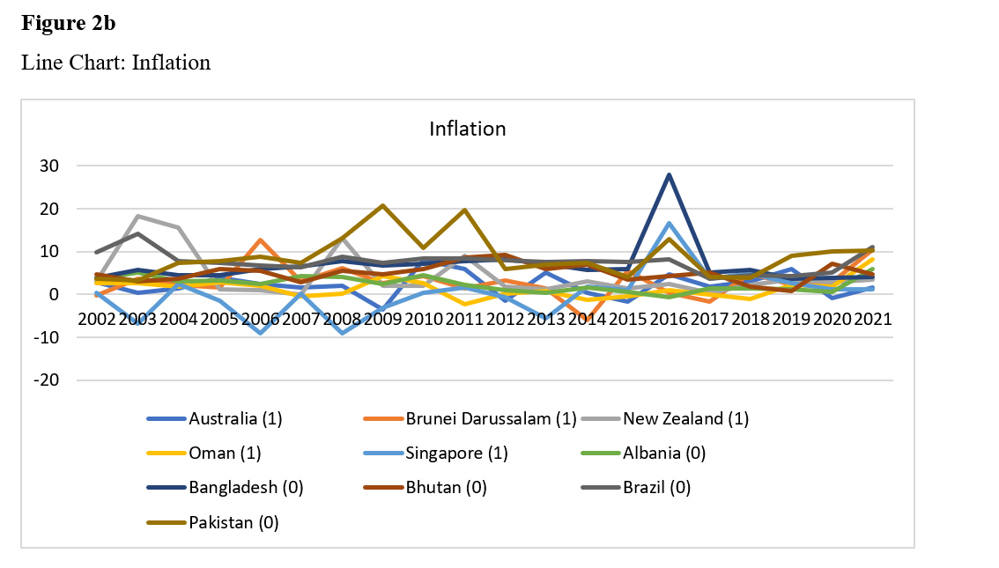
Descriptive : Inflation (2002-2021)

Slide 19
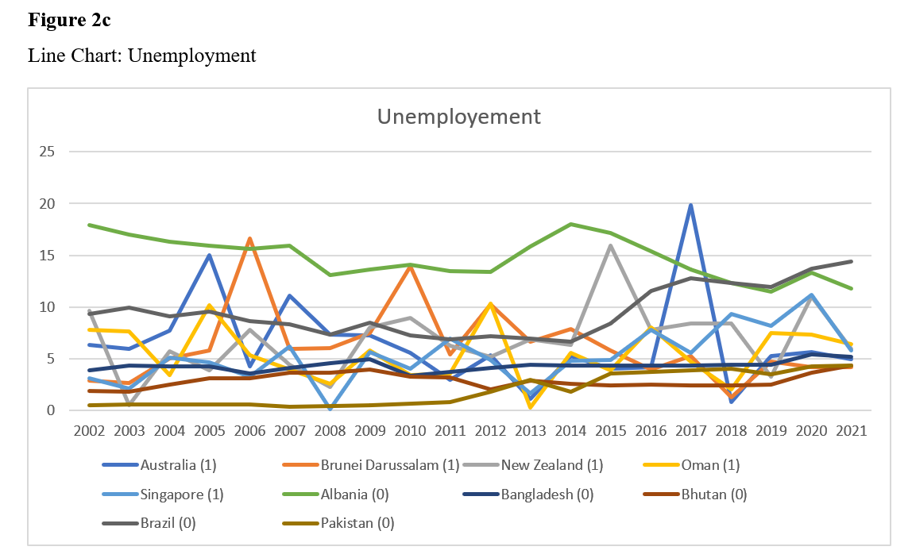
Descriptive : Unemployment (2002-2021)

Slide 20
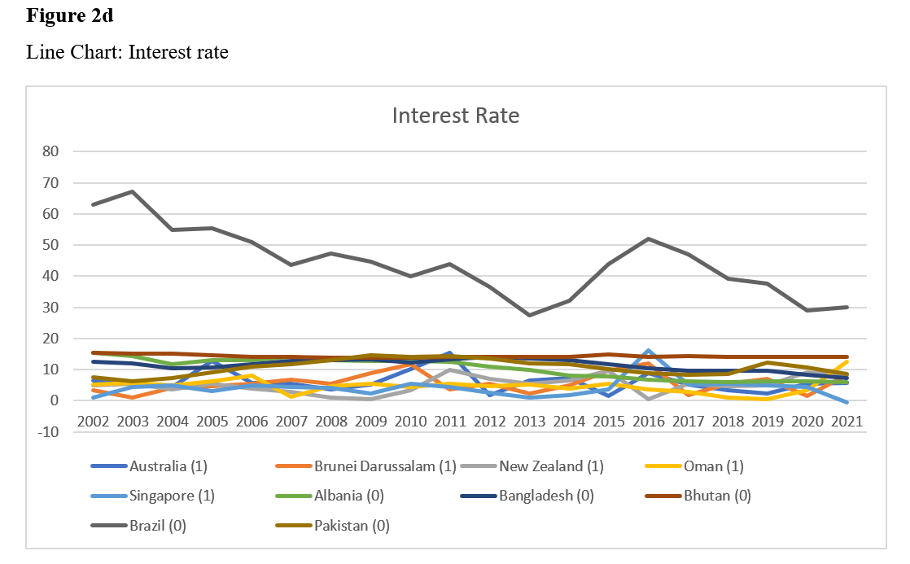
Descriptive : Interest Rate (2002-2021)

Slide 21
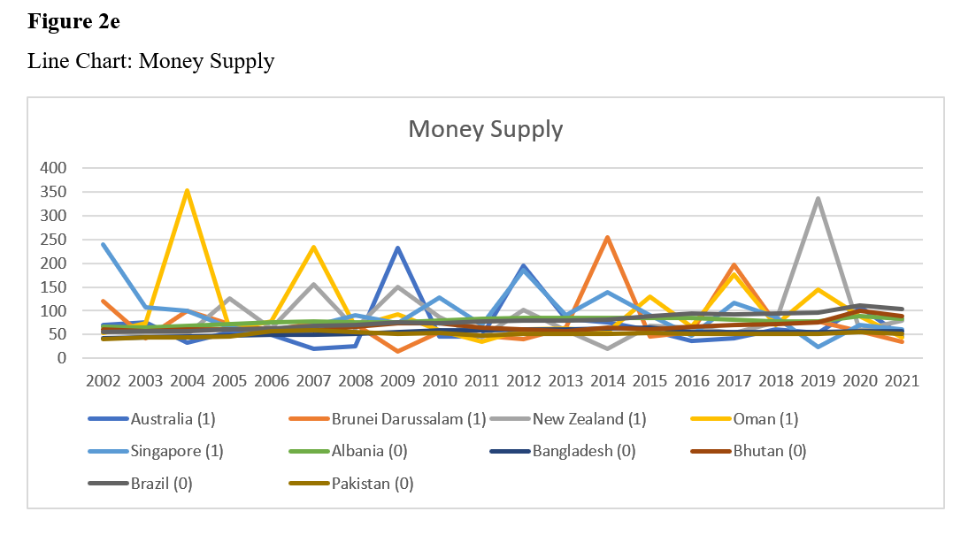
Descriptive : Money Supply (2002-2021)

Slide 22
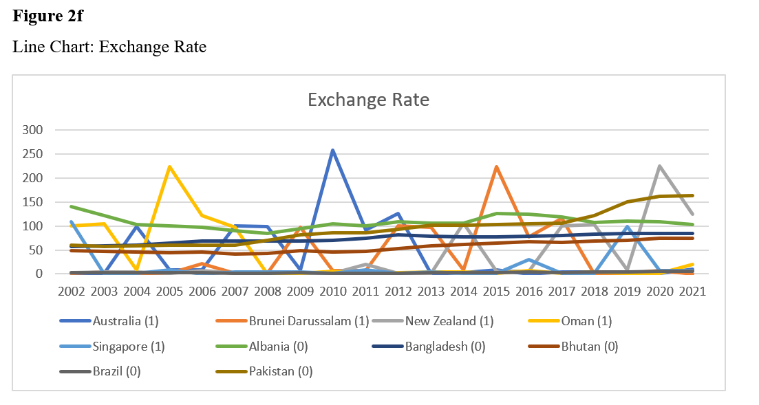
Descriptive : Exchange Rate (2002-2021)

Slide 23
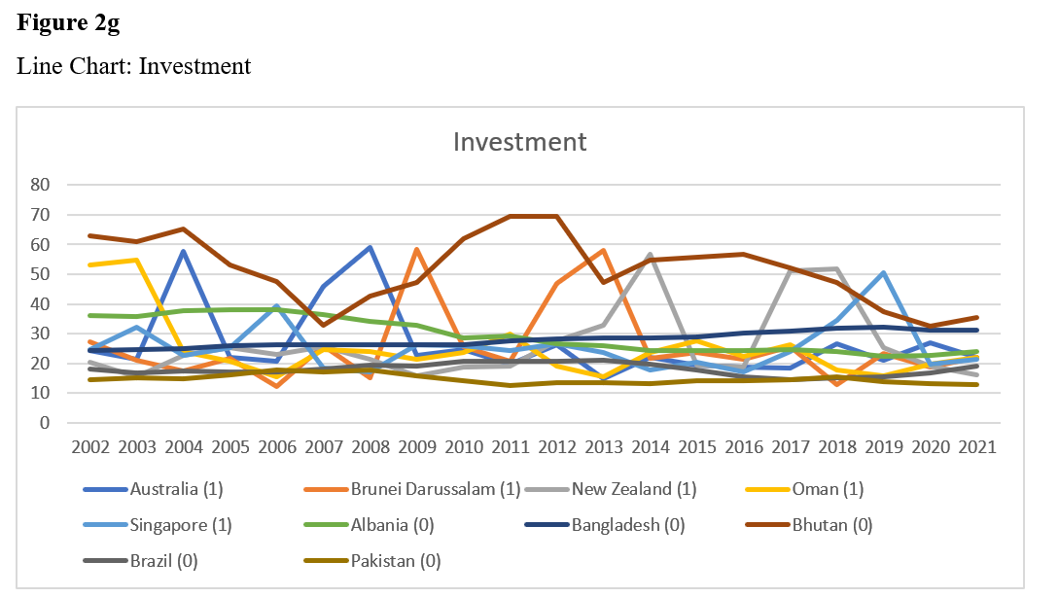
Descriptive : Investment (2002-2021)

Slide 24
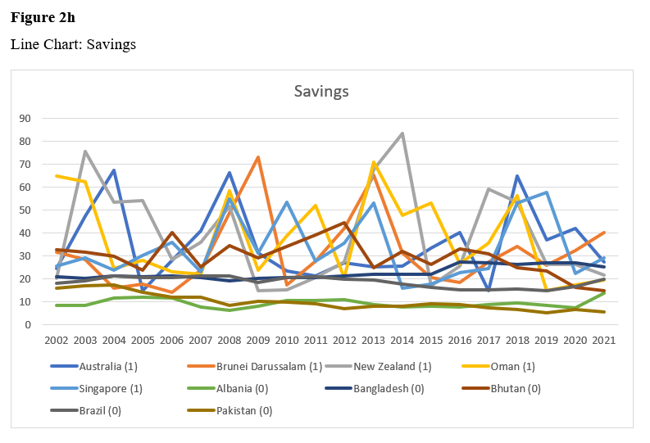
Descriptive : Savings (2002-2021)

